Slide 1
FAEN 301: Numerical Methods
Lecture 3: Solution to Non-Linear Equations (Root finding Problems)
Dr. Nii Longdon Sowah
October 2023

Slide 2
Lecture outline
What are root finding problems?
Roots of equations
Zeros of a function
Simple and duplicate zeros
Types of solutions for nonlinear equations
Bracketing vs open methods
Bisection Method
Newton Raphson Method
The Secant Method

Slide 3
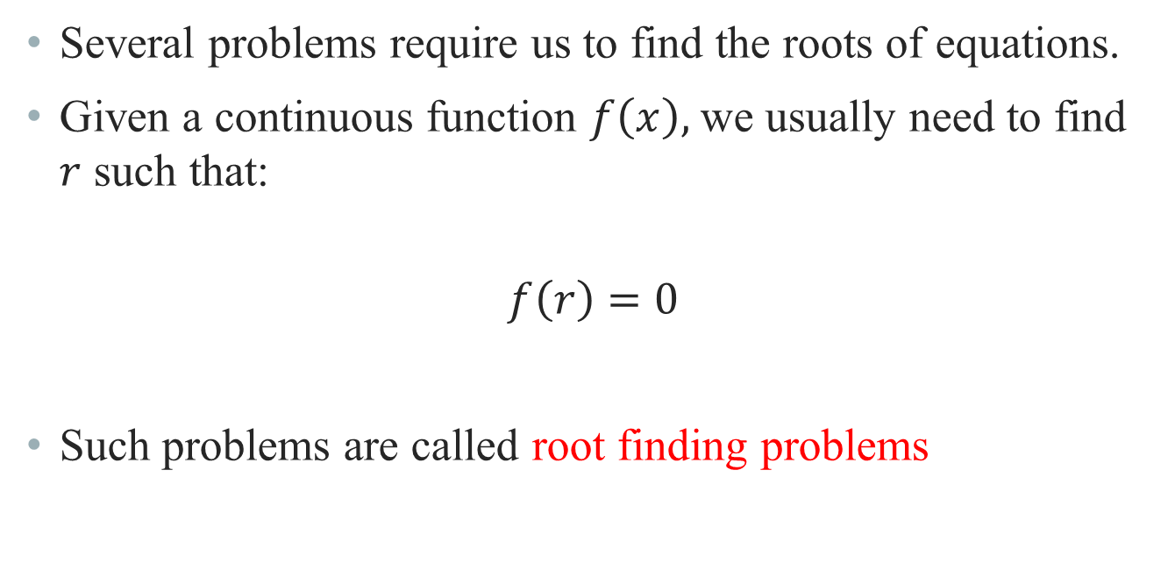
Root finding problems
Several problems require us to find the roots of equations.
Given a continuous function $f\left(x\right),$ we usually need to find $r$ such that:
$$f\left(r\right)=0$$
Such problems are called root finding problems

Slide 4
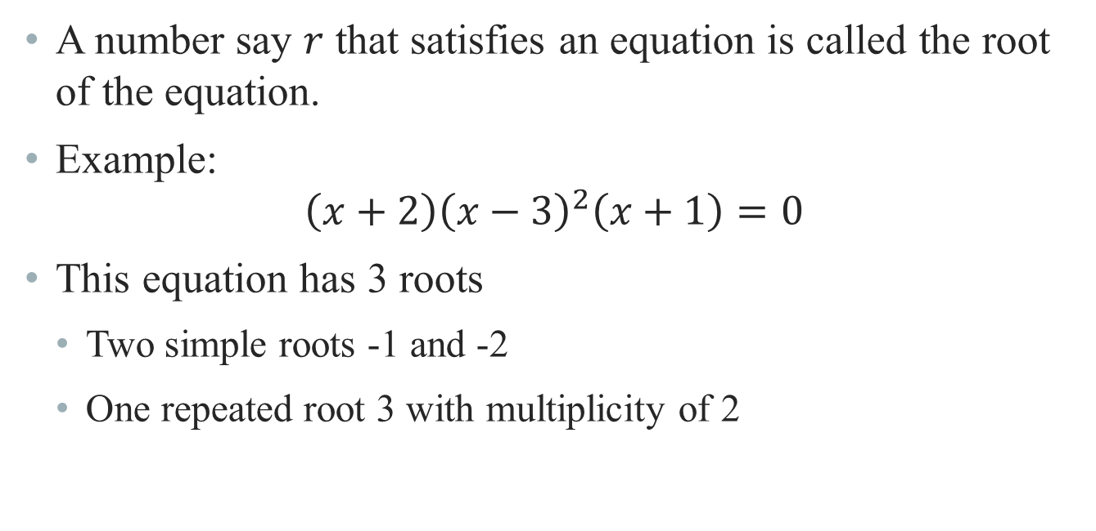
Roots of equations
A number say $r$ that satisfies an equation is called the root of the equation.
Example:
$$\left(x+2\right){\left(x−3\right)}^{2}\left(x+1\right)=0$$
This equation has 3 roots
Two simple roots -1 and -2
One repeated root 3 with multiplicity of 2

Slide 5
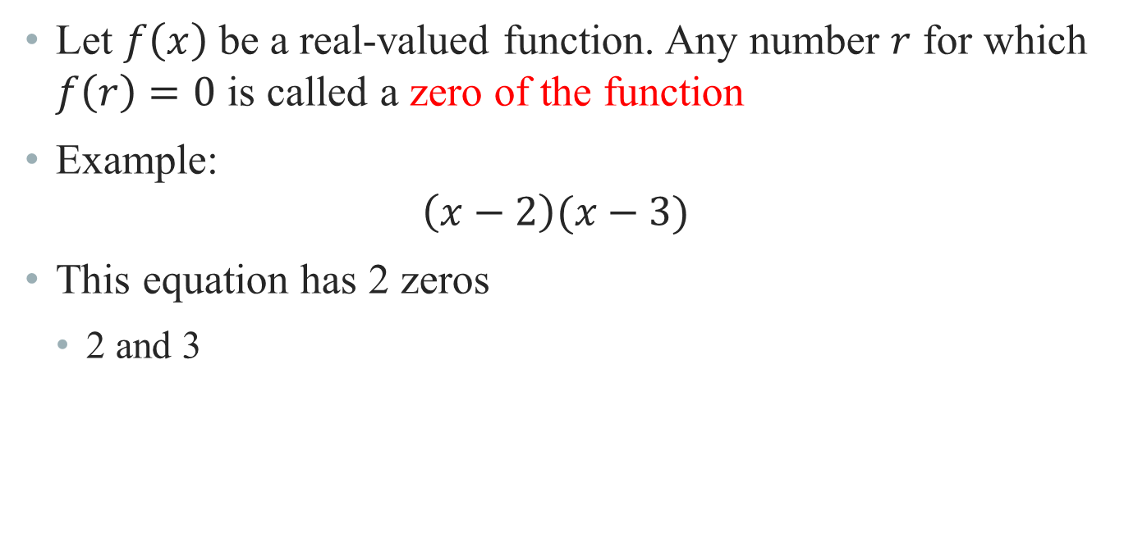
Zeros of a function
Let $f\left(x\right)$ be a real-valued function. Any number $r$ for which $f\left(r\right)=0$ is called a zero of the function
Example:
$$\left(x−2\right)(x−3)$$
This equation has 2 zeros
2 and 3

Slide 6

Graphical interpretation of zeros
The real zeros of a function $f(x)$ are the values of $x$ at which the graph of the function crosses or touches the x-axis.
f(x)

Slide 7
Simple zeros
These are the zeros that occur once

Slide 8
Duplicate zeros
These are the zeros that occur more than once

Slide 9
Duplicate zeros
These are the zeros that occur more than once

Slide 10
Zeros of a function
Any n^{th} order polynomial has exactly n zeros (counting real and complex zeros with their multiplicities).
Any polynomial with an odd order has at least one real zero.

Slide 11
Types of Solutions to Nonlinear equations
There are several ways to solve nonlinear equations:
Analytical Solutions
Possible for special equations only
Graphical Solutions
Useful for providing initial guesses for other methods
Numerical Solutions
Open methods
Bracketing methods

Slide 12
Analytical solutions
Analytical solutions are available for special equations only.

Slide 13
Graphical solutions
Graphical methods are useful to provide an initial guess to be used by other methods.
Root
2
1
1 2

Slide 14
numerical solutions
There are several numerical methods for solving such equations.
Bisection Method
Newton’s Method
Secant Method
Other numerical methods include
False position Method
Muller’s Method
Bairstow’s Method
Fixed point iterations

Slide 15
Bracketing vs Open methods
In bracketing methods, the method starts with an interval that contains the root and a procedure is used to obtain a smaller interval containing the root.
Examples of bracketing methods:
Bisection method
False position method

Slide 16
Bracketing vs Open methods
In the open methods, the method starts with one or more initial guess points. In each iteration, a new guess of the root is obtained.
Open methods are usually more efficient than bracketing methods.
They may not converge to a root

Slide 17
Bisection method
The Bisection method is one of the simplest methods to find a zero of a nonlinear function.
It is also called interval halving method.
To use the Bisection method, one needs an initial interval that is known to contain a zero of the function.
The method systematically reduces the interval. It does this by dividing the interval into two equal parts, performs a simple test and based on the result of the test, half of the interval is thrown away.
The procedure is repeated until the desired interval size is obtained.

Slide 18
Bisection method
Let f(x) be defined on the interval [a,b].
Intermediate value theorem:
if a function is continuous and f(a) and f(b) have different signs then the function has at least one zero in the interval [a,b].
f(a)
a
b
f(b)

Slide 19
Bisection method
If f(a) and f(b) have the same sign, the function may have an even number of real zeros or no real zeros in the interval [a, b].
Bisection method can not be used in these cases.
a
b
a
b
The function has four real zeros
The function has no real zeros

Slide 20
Bisection method
If f(a) and f(b) have different signs, the function has at least one real zero.
Bisection method can be used to find one of the zeros.
a
b
a
b
The function has one real zero
The function has three real zeros

Slide 21
Bisection method
If the function is continuous on [a,b] and f(a) and f(b) have different signs, Bisection method obtains a new interval that is half of the current interval and the sign of the function at the end points of the interval are different.
This allows us to repeat the Bisection procedure to further reduce the size of the interval.

Slide 22
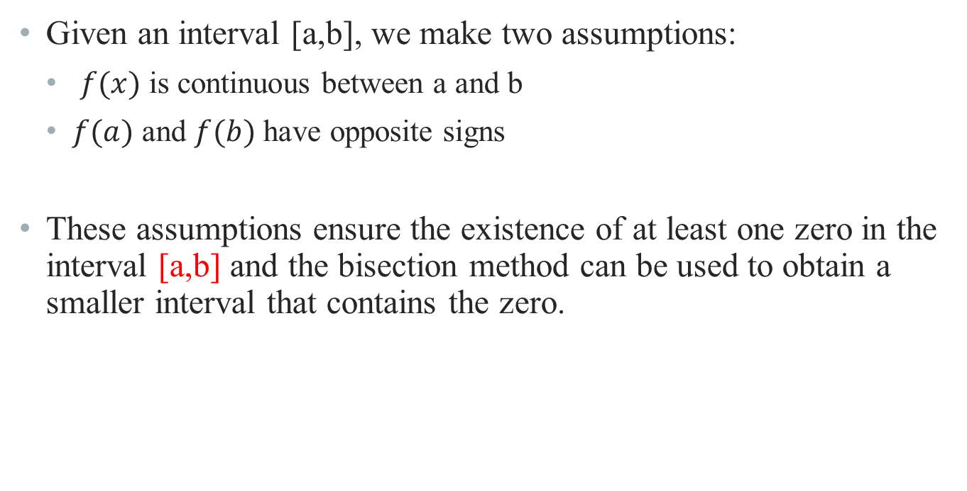
Bisection method
Given an interval [a,b], we make two assumptions:
$f(x)$ is continuous between a and b
$f(a)$ and $f(b)$ have opposite signs
These assumptions ensure the existence of at least one zero in the interval [a,b] and the bisection method can be used to obtain a smaller interval that contains the zero.

Slide 23
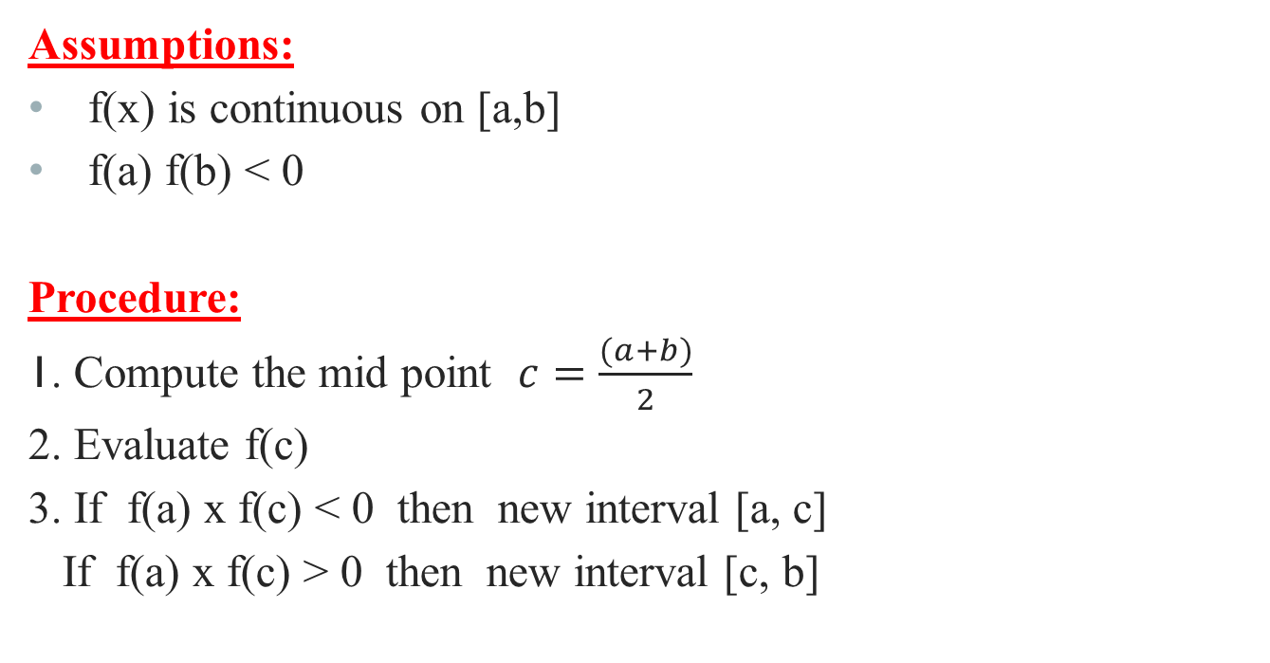
Bisection method
Assumptions:
f(x) is continuous on [a,b]
f(a) f(b) < 0
Procedure:
1. Compute the mid point $c=\frac{(a+b)}{2}$
2. Evaluate f(c)
3. If f(a) x f(c) < 0 then new interval [a, c]
If f(a) x f(c) > 0 then new interval [c, b]
f(a)
c
b
a
f(b)

Slide 24
Flow of Bisection method
Start: Given a,b and ε
u = f(a) ; v = f(b)
c = (a+b) /2 ; w = f(c)
no
yes
is
u w <0
no
is
(b-a) /2<ε
Stop
yes
b=c; v= w
a=c; u= w

Slide 25
Bisection method
Test of assumptions

Slide 26
Bisection method
Test of assumptions

Slide 27
Stopping criteria for Bisection method
There are usually two common stopping criteria
Stop after a fixed number of iterations
Stop when the absolute error is less than a specified value
These two criteria are related. Given a desirable error ξ, we can find the number of iterations required to have an absolute error less than ξ

Slide 28

Stopping criteria for Bisection method
Given $f\left(x\right), a, b and ξ$
How many iterations are needed such that : $|x−r|≤ξ$
Where r is the zero of $f(x)$ and $x$ is the bisection estimate $\frac{(b−a)}{2}$

Slide 29
Stopping criteria for Bisection method

Slide 30
Bisection method example
Find the root of

Slide 31
Bisection method example
Iteration | a | b | c= (a+b) 2 | f(c) | (b-a) 2
1 | 0 | 1 | 0.5 | -0.375 | 0.5
2 | 0 | 0.5 | 0.25 | 0.266 | 0.25
3 | 0.25 | 0.5 | .375 | -7.23E-3 | 0.125
4 | 0.25 | 0.375 | 0.3125 | 9.30E-2 | 0.0625
5 | 0.3125 | 0.375 | 0.34375 | 9.37E-3 | 0.03125

Slide 32
Stopping criteria for Bisection method
Advantages
Simple and easy to implement
One function evaluation per iteration
The size of the interval containing the zero is reduced by 50% after each iteration
The number of iterations can be determined before hand
No knowledge of the derivative is needed
The function does not have to be differentiable
Disadvantages
Slow to converge
Good intermediate approximations may be discarded

Slide 33
Bisection method exercise
Use Bisection method to find a root of the equation x = cos (x) with absolute error <0.02
Assume the initial interval [0.5, 0.9])
Question 1: What is f (x) ?
Question 2: Are the assumptions satisfied ?
Question 3: How many iterations are needed ?
Question 4: What is the solution?

Slide 34
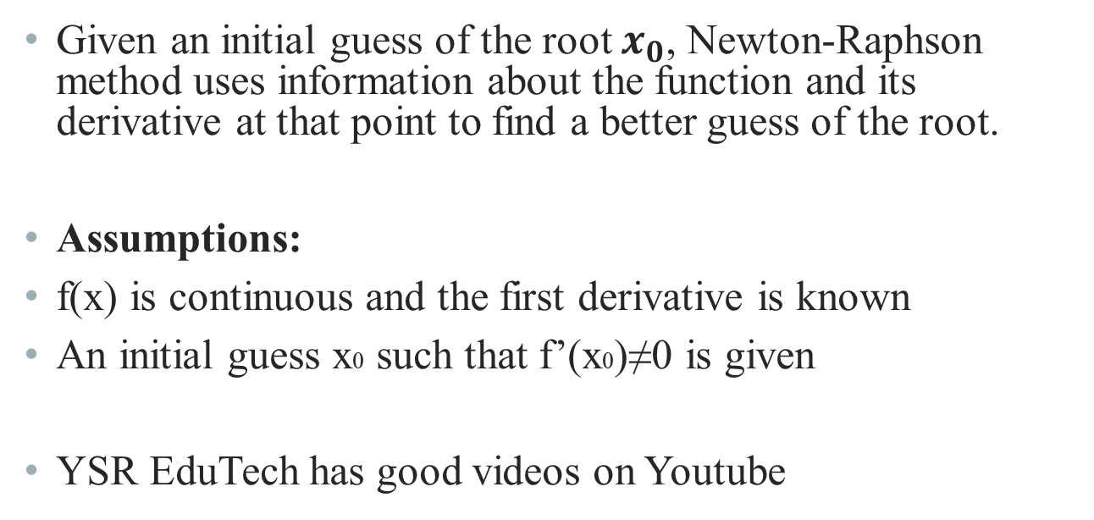
Newton Raphson method
Given an initial guess of the root $x_{0}$, Newton-Raphson method uses information about the function and its derivative at that point to find a better guess of the root.
Assumptions:
f(x) is continuous and the first derivative is known
An initial guess x0 such that f’(x0)≠0 is given
YSR EduTech has good videos on Youtube

Slide 35
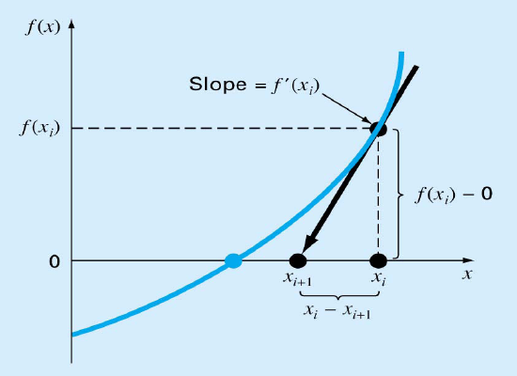
Newton Raphson method – graphical depiction
If the initial guess at the root is x_{i}, then a tangent to the function of x_{i} that is f’(x_{i}) is extrapolated down to the x-axis to provide an estimate of the root at x_{i+1}.

Slide 36
Derivation of Newton’s Method

Slide 37
Implementation
For loop
Mathematical
expression

Slide 38
Newton’s method - example

Slide 39
Newton’s method - example
k (Iteration) | x_{k} | f(x_{k}) | f’(x_{k}) | x_{k+1} | |x_{k+1} –x_{k}|
0 | 4 | 33 | 33 | 3 | 1
1 | 3 | 9 | 16 | 2.4375 | 0.5625
2 | 2.4375 | 2.0369 | 9.0742 | 2.2130 | 0.2245
3 | 2.2130 | 0.2564 | 6.8404 | 2.1756 | 0.0384
4 | 2.1756 | 0.0065 | 6.4969 | 2.1746 | 0.0010

Slide 40
Convergence of newton’s method

Slide 41
Convergence of newton’s method
When the guess is close enough to a simple root of the function then Newton’s method is guaranteed to converge quadratically.
Quadratic convergence means that the number of correct digits is nearly doubled at each iteration.

Slide 42
Problems with the newton’s method
If the initial guess of the root is far from the root the method may not converge.
Newton’s method converges linearly near multiple zeros { f(r) = f’(r) =0 }. In such a case, modified algorithms can be used to regain the quadratic convergence.

Slide 43
Problems with the newton’s method
Runaway
x₀
x₁
The estimates of the root is going away from the root.

Slide 44
Problems with the newton’s method
Flat Spot
x₀
The value of f’(x) is zero, the algorithm fails.
If f ’(x) is very small then x₁ will be very far from x₀.

Slide 45
Problems with the newton’s method
Cycle
x₁=x₃=x₅
x₀=x₂=x₄
The algorithm cycles between two values x₀ and x₁

Slide 46
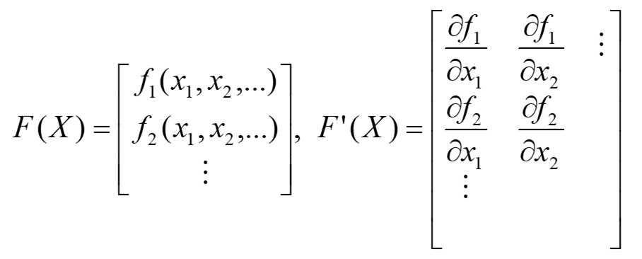

Newtons method – system of nonlinear equations
Given a set of nonlinear equations $F\left(x\right)=0$ and an initial guess $X_{0}$,
Newton’s Iteration:
$$X_{k+1}=X_{k}−{\left[F^{′}\left(X_{k}\right)\right] }^{−1}F(X_{k})$$

Slide 47
system of nonlinear equations – Example 1
Solve the following system of equations:
Solution

Slide 48
system of nonlinear equations – Example 1

Slide 49
Exercise
Solve the following system of equations:

Slide 50
Exercise - solution

Slide 51
The Secant method
In Newton’s method, we had the following:

Slide 52
The Secant method

Slide 53
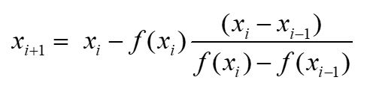

The Secant method
Assumptions:
Choose two initial points $x_{i} and x_{i−1}$ such that
$$f(x_{i})≠f(x_{i−1})$$
New estimate for the secant method:

Slide 54
The Secant method

Slide 55
The Secant method
NO
Yes
Stop

Slide 56

Secant method – Example 1
Find the roots of $f\left(x\right)=x^{5}+x^{3}+3$ at the initial points $x_{0}=−1 and x_{1}=−1.1$ with error < 0.001.
x(i) | f(x(i)) | x(i+1) | |x(i+1)-x(i)|
-1.0000 | 1.0000 | -1.1000 | 0.1000
-1.1000 | 0.0585 | -1.1062 | 0. 0062
-1.1062 | 0.0102 | -1.1052 | 0.0009
-1.1052 | 0.0001 | -1.1052 | 0.0000

Slide 57
Secant method – convergence
The rate of convergence of the Secant method is super linear:
It is better than Bisection method but not as good as Newton’s method.

Slide 58
Summary
Method | Pros | Cons
Bisection | Easy, Reliable, Convergent - One function evaluation per iteration - No knowledge of derivative is needed | - Slow - Needs an interval [a, b] containing the root, i.e., f(a)f(b)<0
Newton | Fast (if near the root) - Two function evaluations per iteration | - May diverge - Needs derivative and an initial guess x0 such that f’(x0) is nonzero
Secant | - Fast (slower than Newton) No knowledge of derivative is needed - One function evaluation per iteration | - May diverge - Needs two initial points guess x0, x1 such that f(x0)- f(x1) is nonzero

Slide 59
Exercise 2 – Newton’s Method

Slide 60
Exercise 2 solution – Newton’s Method
k x_{k} f(x_{k}) f’(x_{k}) ERROR
______________________________________
0 1.0000 -1.0000 2.0000
1 1.5000 0.8750 5.7500 0.1522
2 1.3478 0.1007 4.4499 0.0226
3 1.3252 0.0021 4.2685 0.0005
4 1.3247 0.0000 4.2646 0.0000
5 1.3247 0.0000 4.2646 0.0000

Slide 61
Exercise 3 – Newton’s Method

Slide 62
Exercise 3 solution – Newton’s Method

Slide 63
Exercise 1 – Secant Method

